Slide 1
Performing Sentiment Analysis on Amazon Reviews
By: Snehal Bichkar
Anjitha Karattu Thodi
Shreya Kundu

Slide 2
Agenda
Aim
Motivation
Tools
Dataset
Data Preprocessing
Methodology & Results
Incorporating Kafka
Demo
Challenges, Conclusion & Future work

Slide 3

Aim
To create a model which learns to identify the sentiment in an Amazon user review, and train the model to predict if given review is Positive or Negative
Compare the performance of traditional sentiment analysis
models with deep learning models.

Slide 4
Motivation
Texts are not actionable but numbers are!
Companies receive feedback for their products and services on several platforms (Twitter, Facebook Pages, Forums, etc) - requires too many resources to analyse.
If these feedback can automatically be converted to numbers, companies can use them to improve their products, perform market analysis, etc
In this project, we have focused on analyzing Amazon reviews, but our model can be used to analyze any similar data!

Slide 5

What is Sentiment Analysis?
Simply put, Sentiment Analysis is the process of determining whether a piece of writing is positive, negative or neutral.
The sentiment analysis task can be modeled as a classification
problem where a classifier is fed with a text and returns the
corresponding category, e.g. positive, negative, or neutral

Slide 6
Tools used
Python 3
Pycharm/Jupyter Notebook
Kafka
Keras
Sklearn
NLTK
Numpy
Pandas
Matplotlib

Slide 7
Dataset
We decided to work on 2 datasets to study the effects of sentiment analysis on data with 2 labels vs data with several labels.
Dataset1: https://www.kaggle.com/bittlingmayer/amazonreviews (csv format) containing 400k reviews, each labelled as 1 (Negative) or 2 (Positive)
Dataset2: http://jmcauley.ucsd.edu/data/amazon/ (Json format) containing nearly 200k reviews, each labelled between from 1 to 5 based on the user Ratings.

Slide 8
Data Preprocessing
Handled missing values
Read the data in the files (csv and json) to pandas dataframe
Removed numbers, special characters, etc from the text.

Slide 9
Data Split
We split the given data into two parts.
Training dataset used: nearly 70%
Test dataset used: nearly 30% for testing the accuracy and effectiveness of the model.
Dataset 1: 320k training samples and 80k test samples.
Dataset 2: 159k training samples and 39k test samples.

Slide 10
Methodology 1
Used a Logistic regression model-one of the most common models for sentiment analysis.
Performed traditional text preprocessing such as Stemming, Stopping and TFIDF vectorization
Stemming - Converting “running” and “runs” to “run” so that all 3 are considered the same
Stopping - Removal of function words like “the” and “and” which do not serve any purpose in our context
TFIDF Vectorization - We split the sentences into words and assign scores to them.

Slide 11
Methodology 2
Used Convolution Neural Network (CNN) with 5 layers.
Activation function : Relu and Sigmoid (output layer) for Data1
Activation function : Relu and Softmax (output layer) for Data2
Used Cross Entropy as loss function (Binary CE for Data1 and Categorical CE for Data2)
Used Dropout Regularization to avoid overfitting. (Dropout = 0.5)

Slide 12
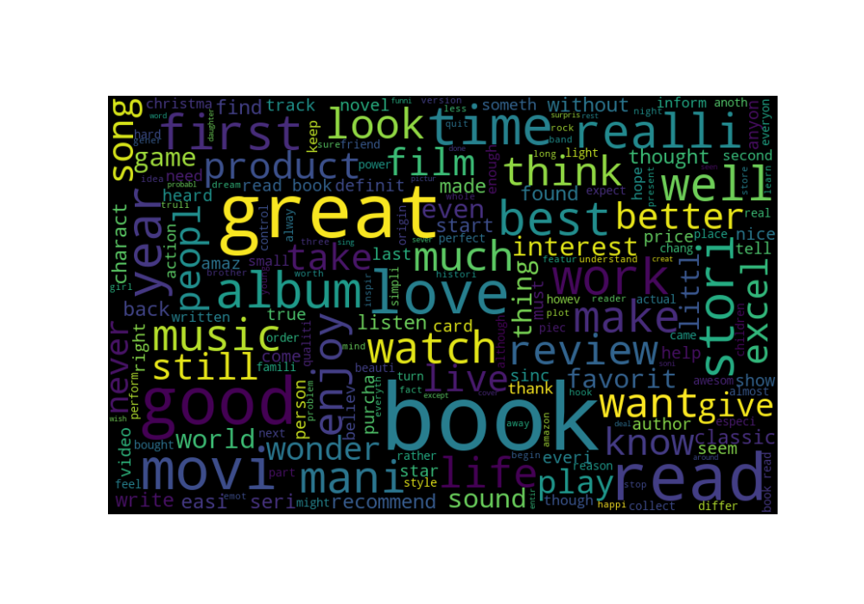
Word Cloud- Positive Reviews

Slide 13
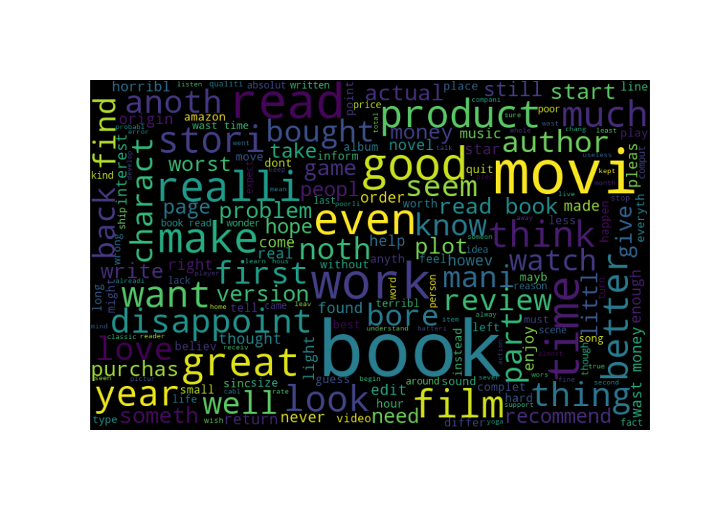
Word Cloud - Negative Reviews

Slide 14
RESULTS

Slide 15
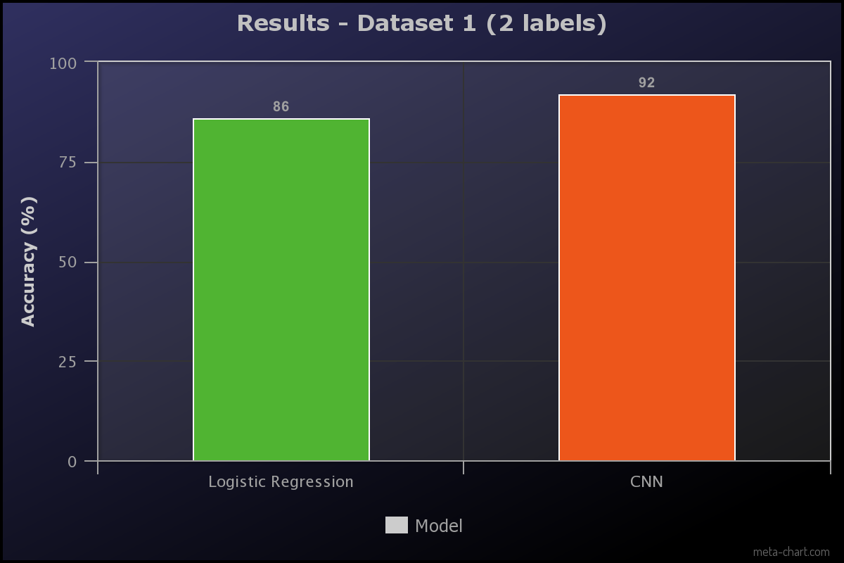
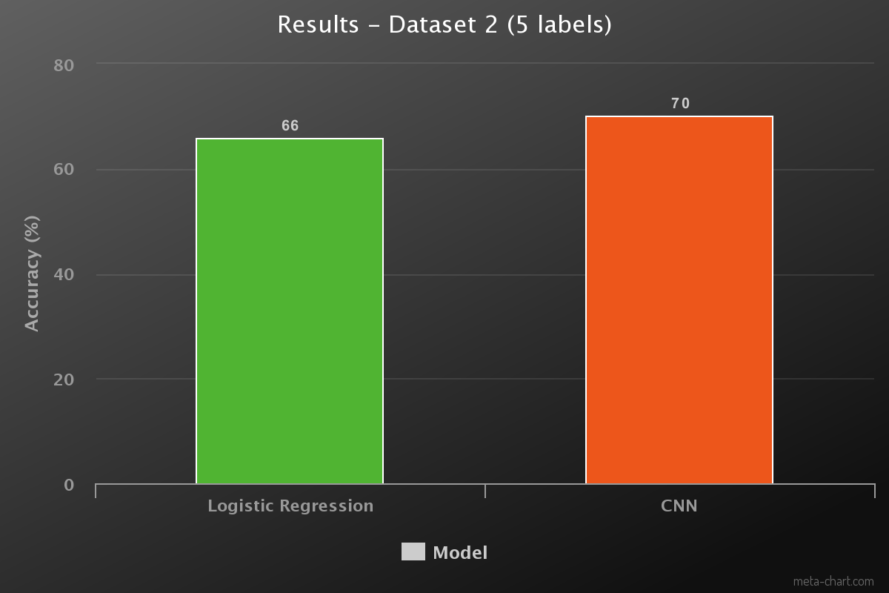

Slide 16
Inclusion of Kafka-MessageBus service
Kafka-Python –Python client for the Apache Kafka distributed stream processing system. kafka-python is designed to function much like the official java client, with a sprinkling of pythonic interfaces (e.g., consumer iterators).
We did asynchronous streaming of data.
Used kafka streaming service, with the help of Kafka Producer to send the predictions over messagebus to consumers in real-time
Streamed the predictions from the consumer and also created an excel file along side for future reference and analysis.

Slide 17
Kafka steps
1.Save the trained model .Various python libraries are available for doing this.We used pickle library.
2.Load the trained model in the workspace
3.Import the test data
4.Create a class whose class variables are one Producer and one Consumer.
5.Producer sends the predictions given the trained model along with the product ID over the kafka message bus.
6.Consumer reads the data from the message bus and streams it alongside saving it to an excel.

Slide 18
Conclusion
Unsurprisingly, both the sentiment analysis models we created worked better for the 2-label dataset than the 5-label dataset.
It is difficult to classify data into 5 labels in case of measures like Ratings. For example, a person who gives the review: “Satisfied with the product. Will buy again” for a product may give it 4 or 5 stars, depending on her preference. There is no clear criteria for her choice between the two..
In both cases, our deep learning model without any text pre-processing performed better than the logistic regression model with Stemming, Stopping and TFIDF Vectorization.

Slide 19
Challenges
Due to the large size of datasets, the program took long time to run.
Improving model accuracy for the second dataset when there are multiple sentiment labels(positive,strongly positive ,neutral,negative,strongly negative).

Slide 20
Future work
Work on improving the results on 5 label dataset
Understand Sarcastic reviews to improve performance

Slide 21
Thank You
Questions??

